Slide 1
RHDBank
Discourse Tasks
Control Participants

Slide 2
These instructions explain how to administer the discourse tasks of the RHDBank protocol and include the detailed script for examiners to follow.
Allow ample time for as full a response as each participant can provide using this protocol script. However, also pay attention to the maximum time recommended for each task. If the participant is still talking once that time period has elapsed, bring that task to an end by saying:
“I'm going to stop you there so we can move on to the next item.”
To facilitate transcription, the examiner's speech, including verbal encouragers, should be kept to a minimum. Use nonverbal encouragers (e.g., head nods, facial expressions, eye contact) instead of verbal encouragers (e.g., “I see”, “mhm”, “yeah”) whenever possible.

Slide 3
SECTION I: FREE SPEECH SAMPLES
Start with a preliminary unrecorded conversation for social exchanges, signing consent forms, explaining about recording the session, answering any questions, and so forth.
BEGIN RECORDING
If your institution requires it, record the following preamble about informed consent, then lead in to the first recorded protocol item (Illness Story). If not, go straight to the Illness Story.
Investigator: "This participant has signed an informed consent form. These data can be used for ______________ (specify: research, teaching, or any purpose). These data are not to be used for ____________ (specify any restrictions)."

Slide 4
A. ILLNESS and COPING
“In this research project, I ask people who've had strokes to tell me what they remember about when they had their stroke. Since you haven't had a stroke, I wonder if you could tell me what you remember about any illness or injury you've had.”
(~ 4 minutes)
If no response in approximately 10 seconds, prompt:
“Tell me about any time you’ve been sick or hurt.”

Slide 5
2. “Tell me about your recovery from that illness (or injury).
What kinds of things did you do to get better?" (~ 4 minutes)
If no response in approximately 10 seconds, prompt:
“Tell me about any things you did to get well.”

Slide 6
3. “Have you had any experience with people who have a difficult time communicating?” (~ 2 minutes)
If yes, “Please tell me what the problems were and what you did about it.”
If no, “Have you ever had trouble communicating with someone, like
talking to people from another country?”
If no response in approximately 10 seconds, prompt:
“Tell me about a time when you had trouble communicating
with someone or someone had trouble communicating with you.”

Slide 7
“Now I’m going to ask you to do a few more things where you need to talk. Please talk as much as you can about each one, because we’re really interested in knowing about your language."
B. FIRST ENCOUNTER (~ 5 minutes)
Instructions to Student (done prior to session):
“This is not an interview. Converse as you would with anyone you have met for the first time. Allow the partner to initiate topics.”
Instructions to Participants:
"I'd like you to meet one of my students. (If being administered by a student clinician, say: “I'd like you to meet another student here.") I don't think you've met her/him before. This is a chance for you to get to know each other. This is not an interview, so s/he doesn’t have a list of questions to ask you. See what you can get to know about her/him."

Slide 8
SECTION II: PICTURE DESCRIPTIONS
“Now let’s look at some pictures.”

Slide 9
Picture #1

Slide 10
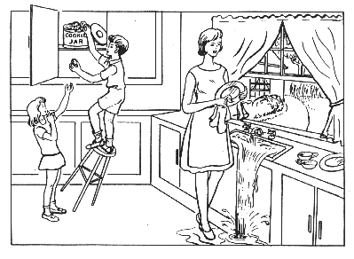
Notes:
Present picture #1 (Cookie Theft) (~ 3 minutes)
“Here is a picture. Tell me everything you see going on in this picture.”
If no response in 10 seconds, give second prompt:
“Take a look (point to picture if possible) and tell me what’s happening in the picture.”
If fewer than 2 utterances, give third prompt:
“Anything else you can tell me about the picture?”

Slide 11
Picture #2

Slide 12
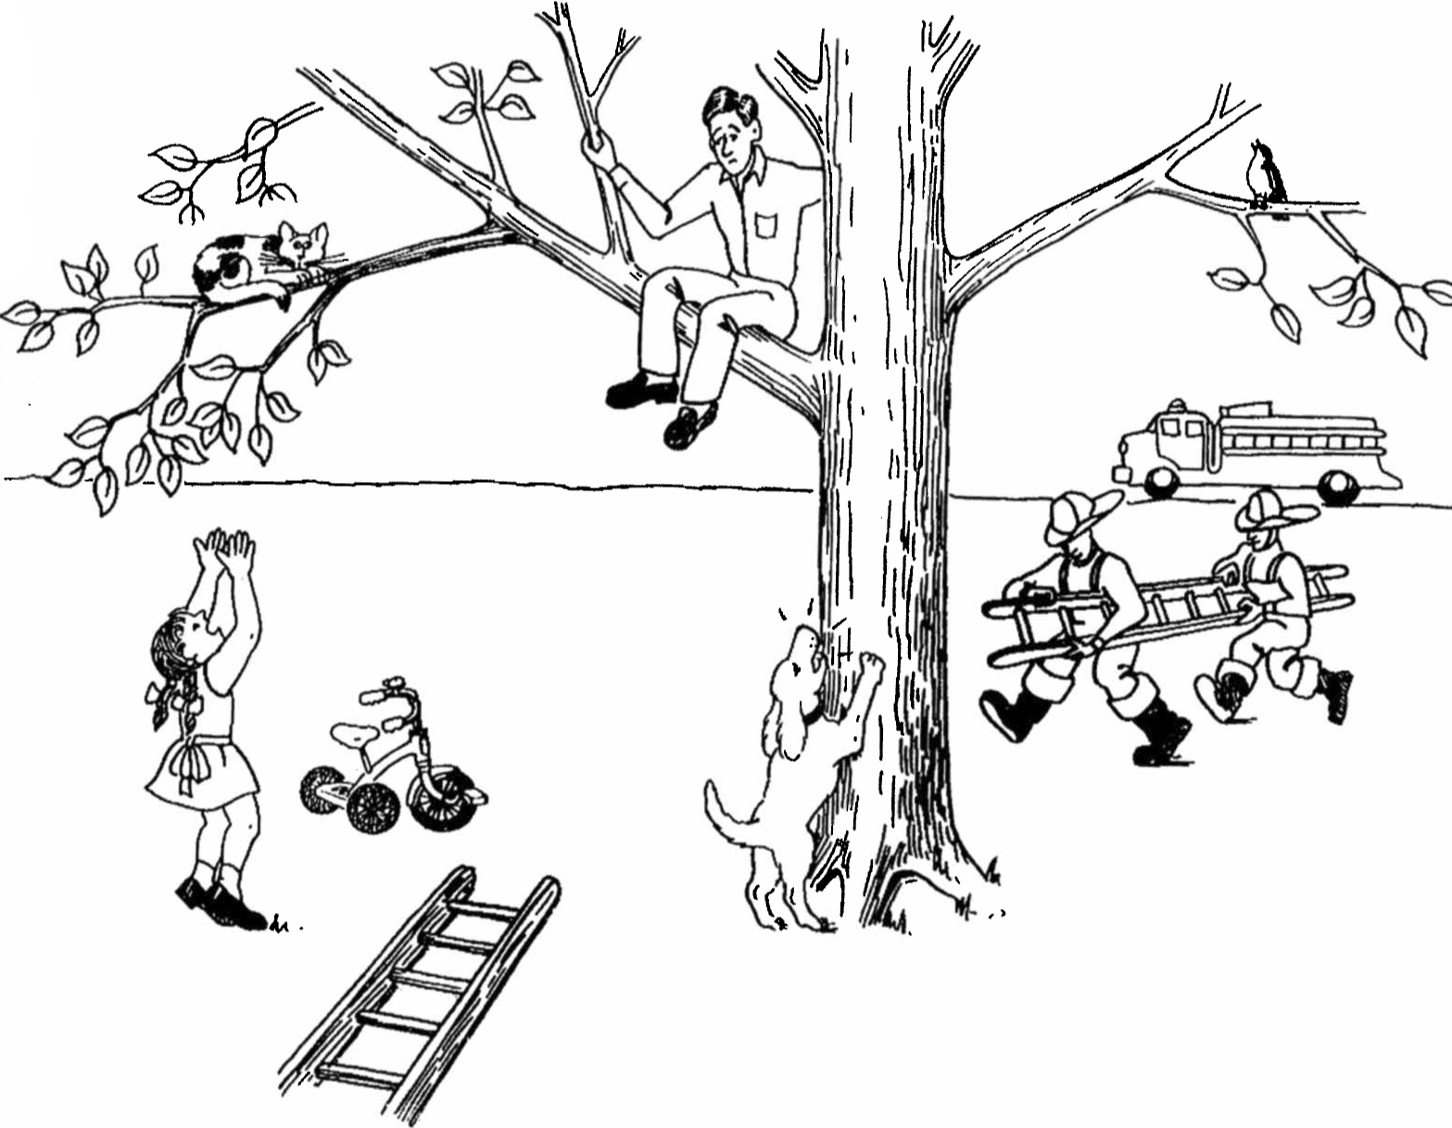
Notes:
Present Picture #3 (Cat Rescue) (~ 3 minutes)
“Here is another picture. Look at everything that’s happening and then tell me a story about what you see. Tell me the story with a beginning, a middle, and an end.”
If no response in 10 seconds, give second prompt:
“Take a look (point to picture, if possible) and tell me any part of the story.”
If fewer than 2 utterances, give third prompt:
“Anything else you can tell me about the story?”

Slide 13
Story Narrative

Slide 14
Notes:
CINDERELLA (~ 5 minutes)
“I’m going to ask you to tell a story. Have you ever heard the story of Cinderella? (Make note of answer for demographic data. If answer is no, ask participant to tell a fairy tale s/he knows.)
Do you remember much about it? Take a look through the pictures from the story book. They might remind you of how it goes. Then, after you finish looking at the pictures, you can tell me the story in your own words.”
After participant looks through all the pictures, remove the book or the pictures and prompt:
“Now tell me as much of the story of Cinderella as you can. You can use any details you know about the story, as well as the pictures you just looked at.”
If participant gives a response of fewer than three utterances, or seems to falter, allow 10 seconds, then prompt:
“What happened next?” or “Go on.”
Continue until participant concludes story or has clearly finished. HOWEVER, if the participant is still telling the story after 5 minutes have elapsed, then prompt:
“Sorry to interrupt, but please try to finish up with the rest of the details of the story so we can get to the other things we still have to do.”
If the participant does not finish after 1 more minute, then prompt:
"Okay, just tell me how the story ends. We have to move on."

Slide 15
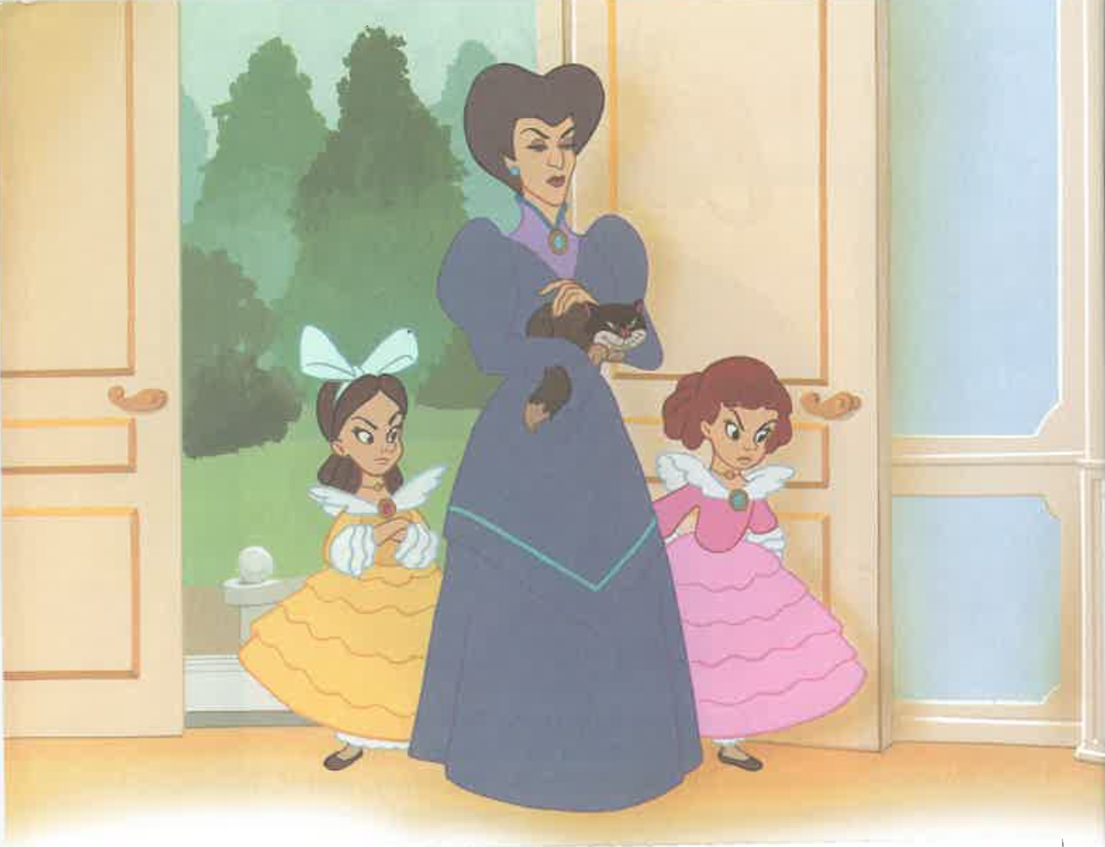

Slide 16
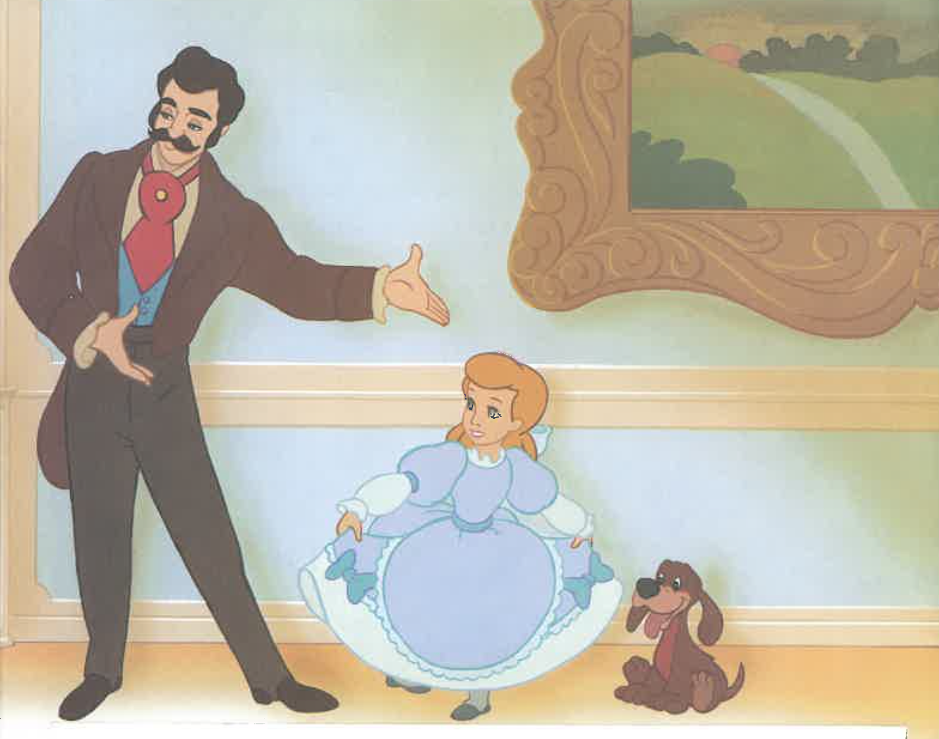

Slide 17
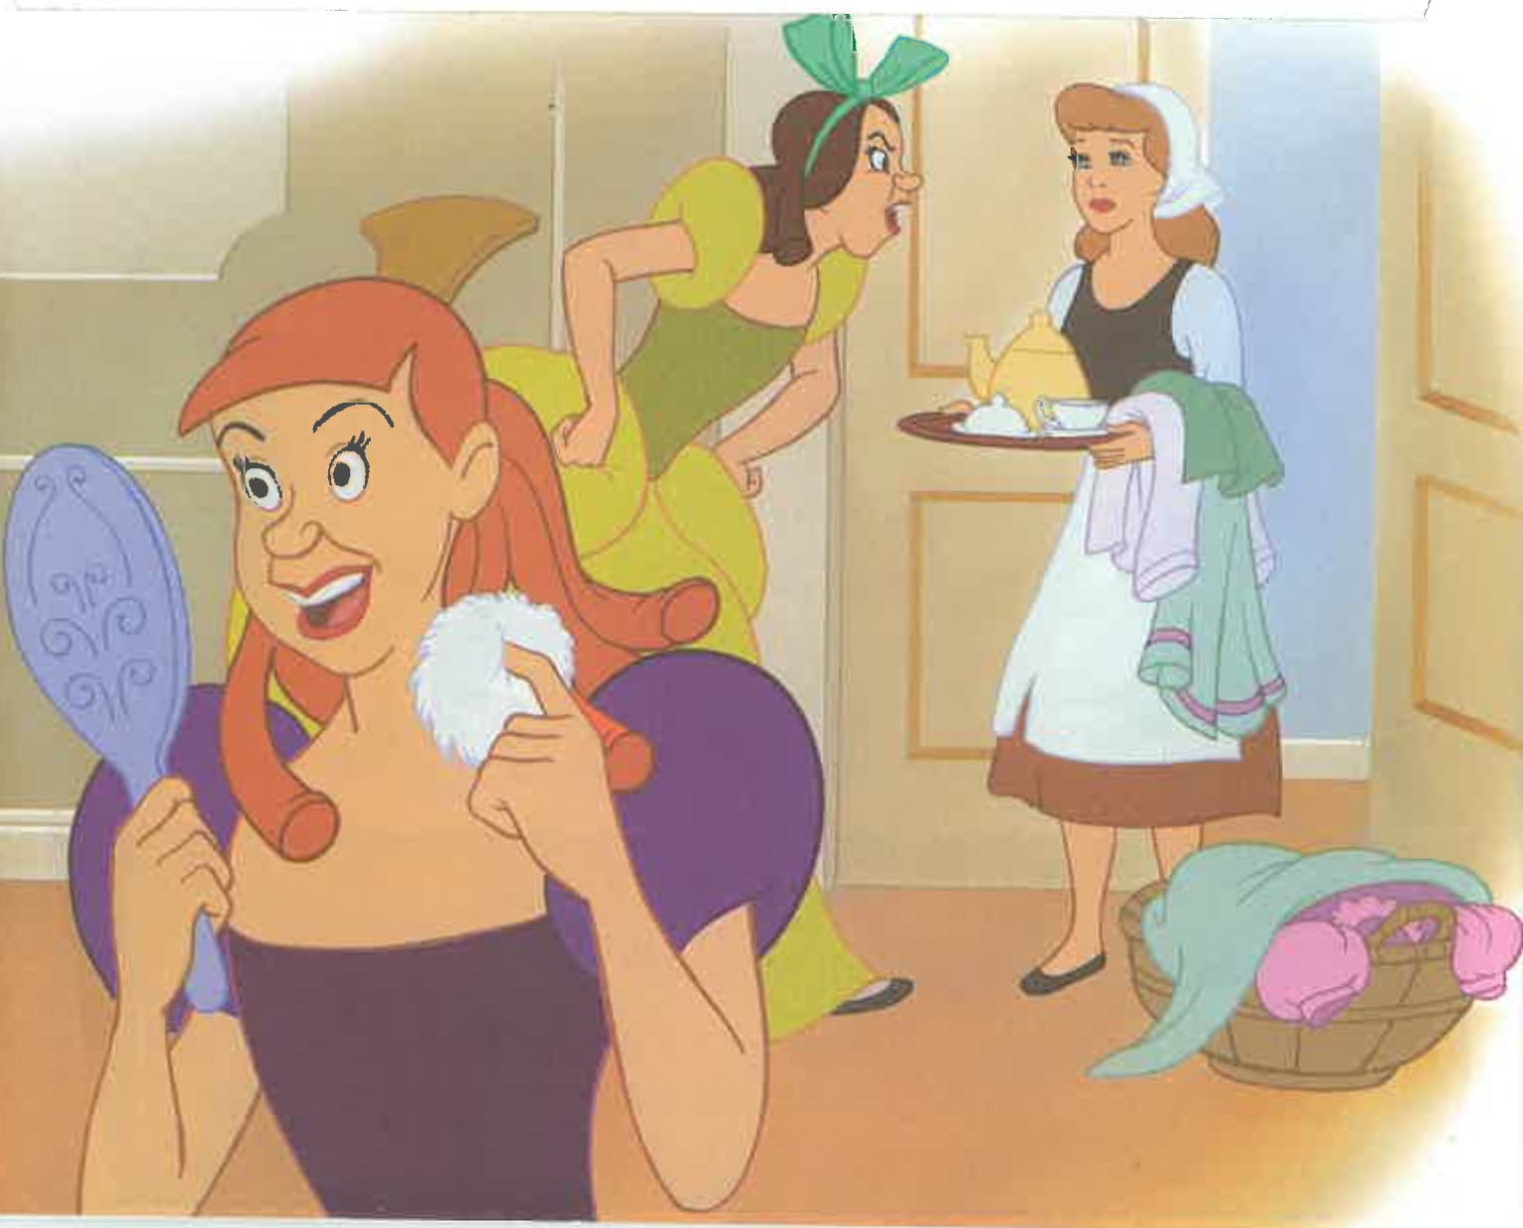

Slide 18
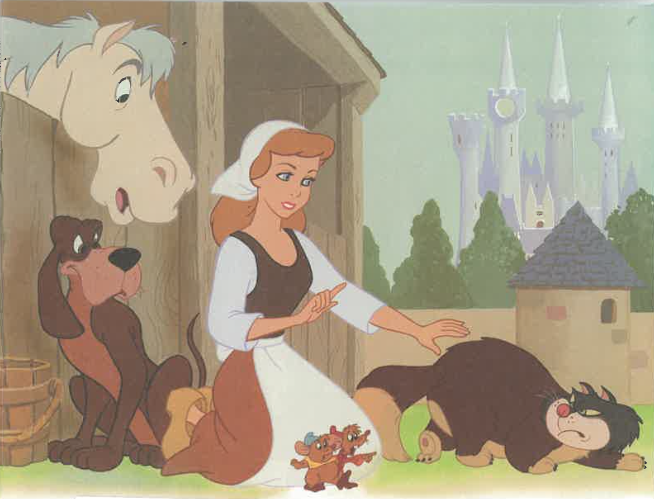

Slide 19
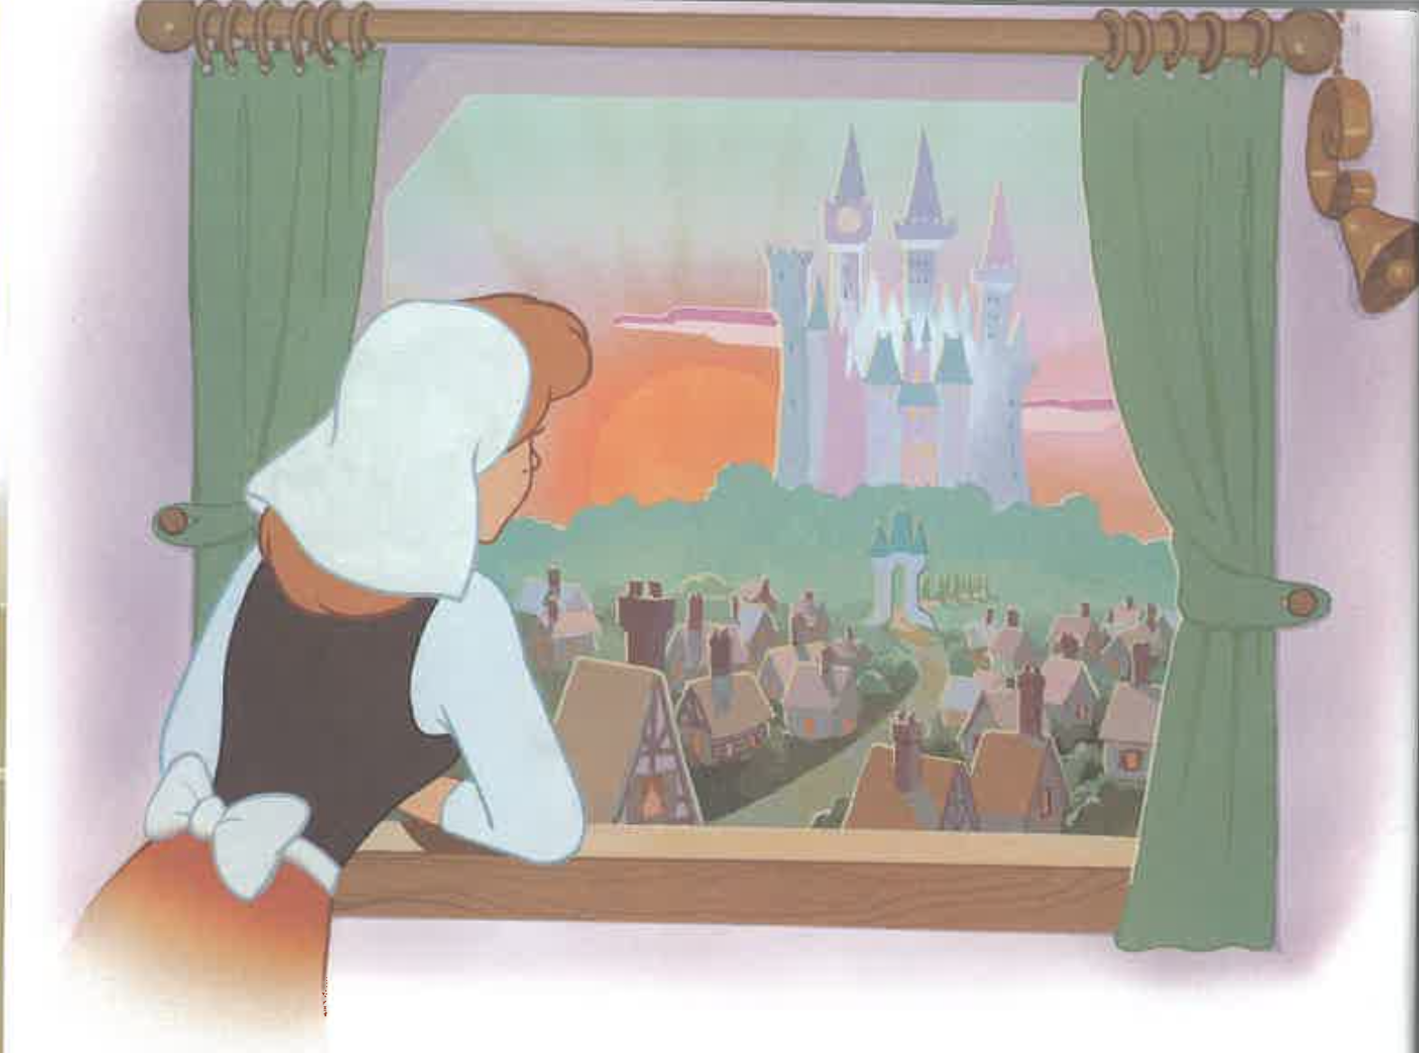

Slide 20
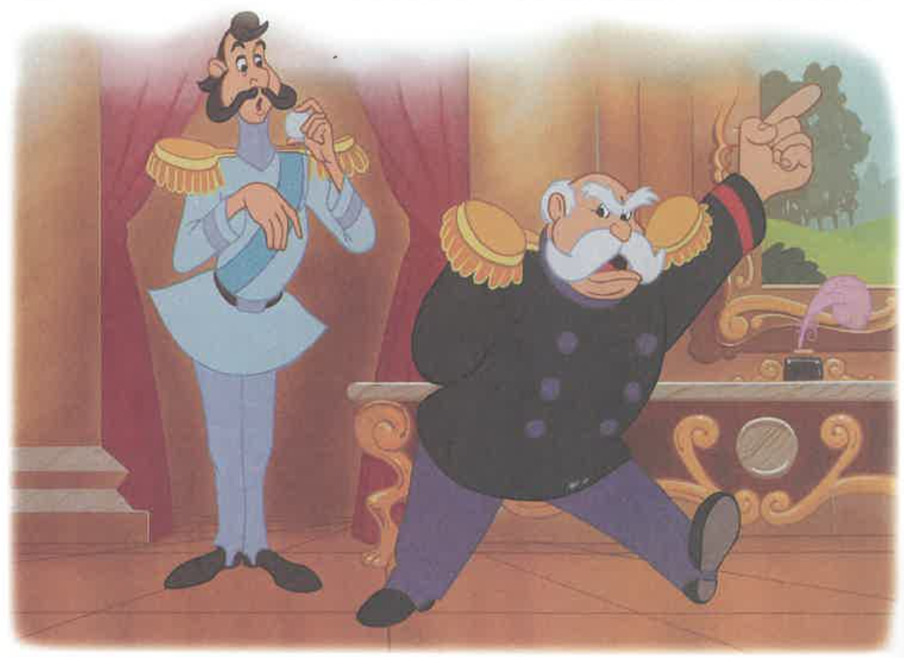

Slide 21
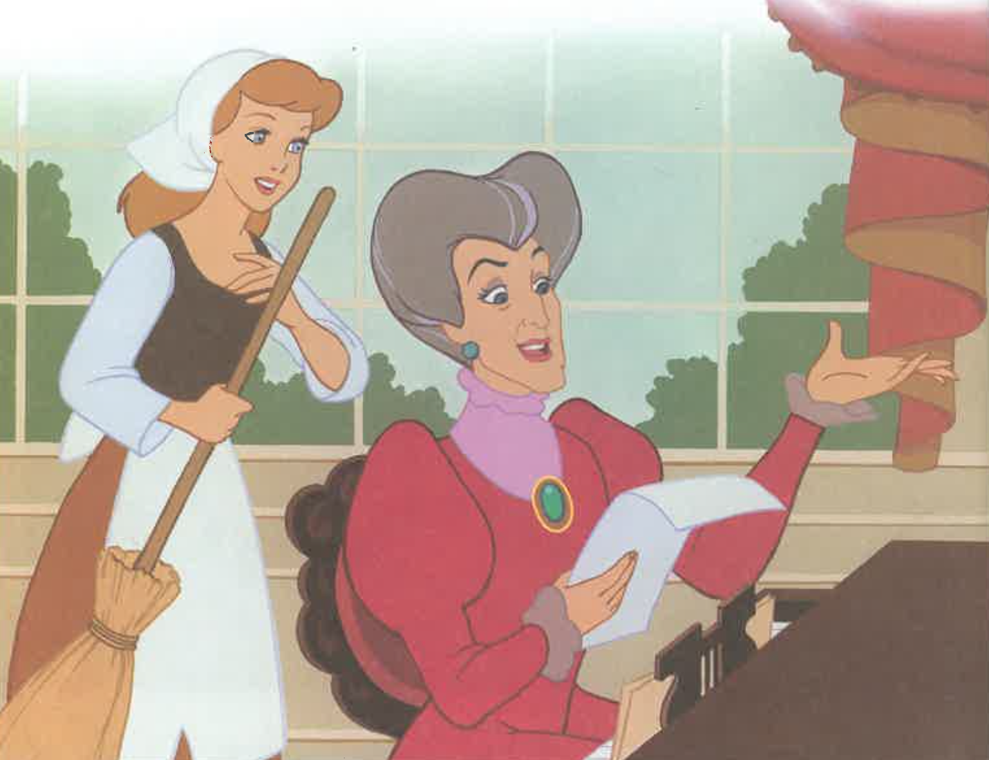

Slide 22
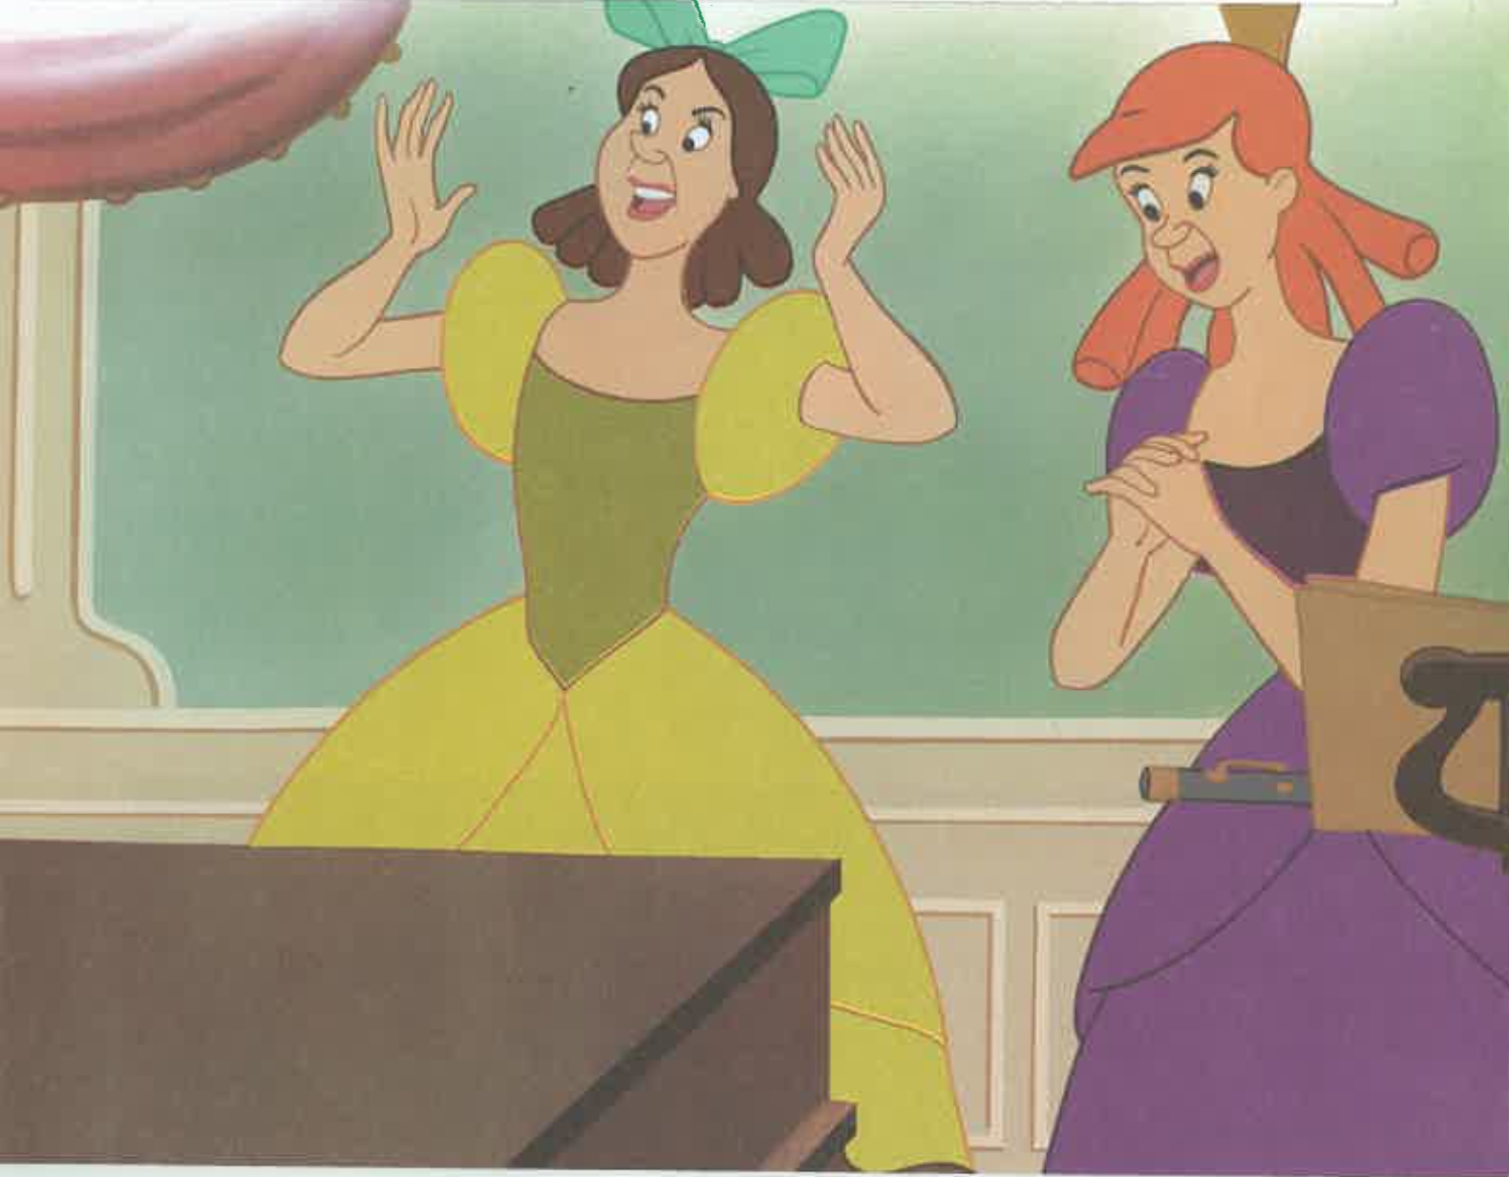

Slide 23
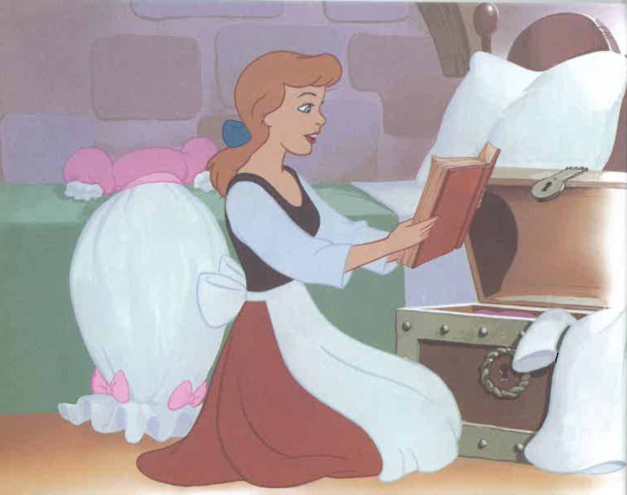

Slide 24
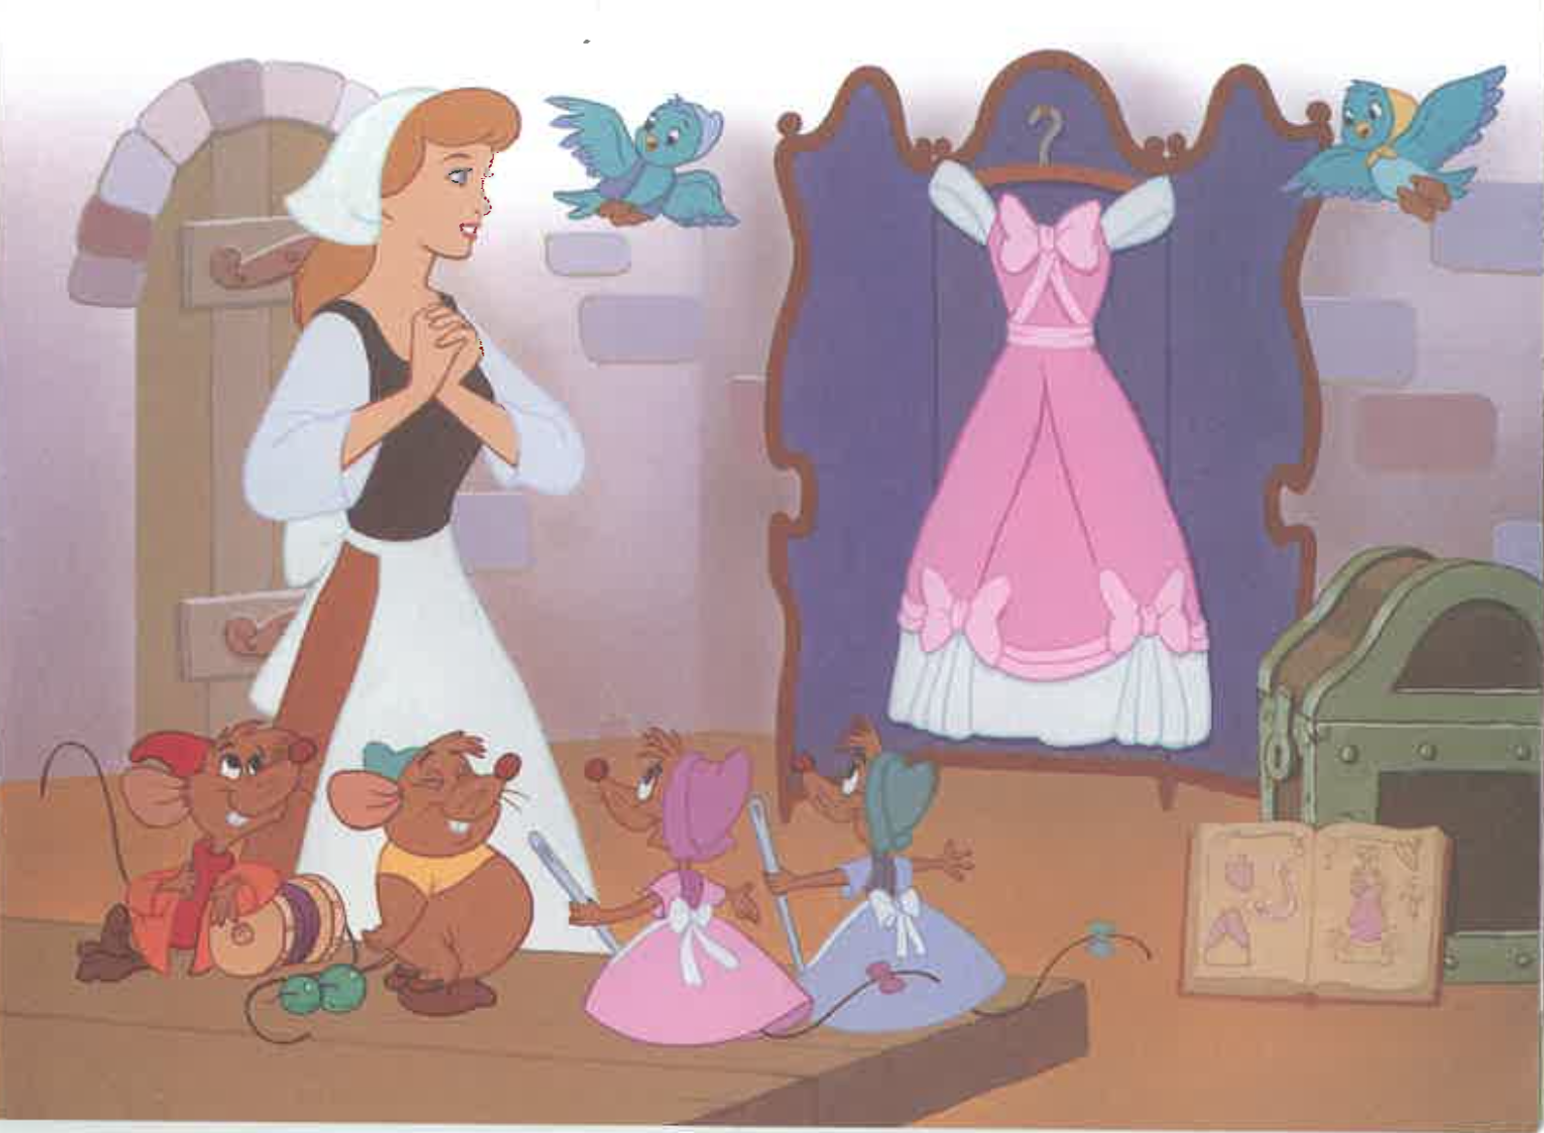

Slide 25
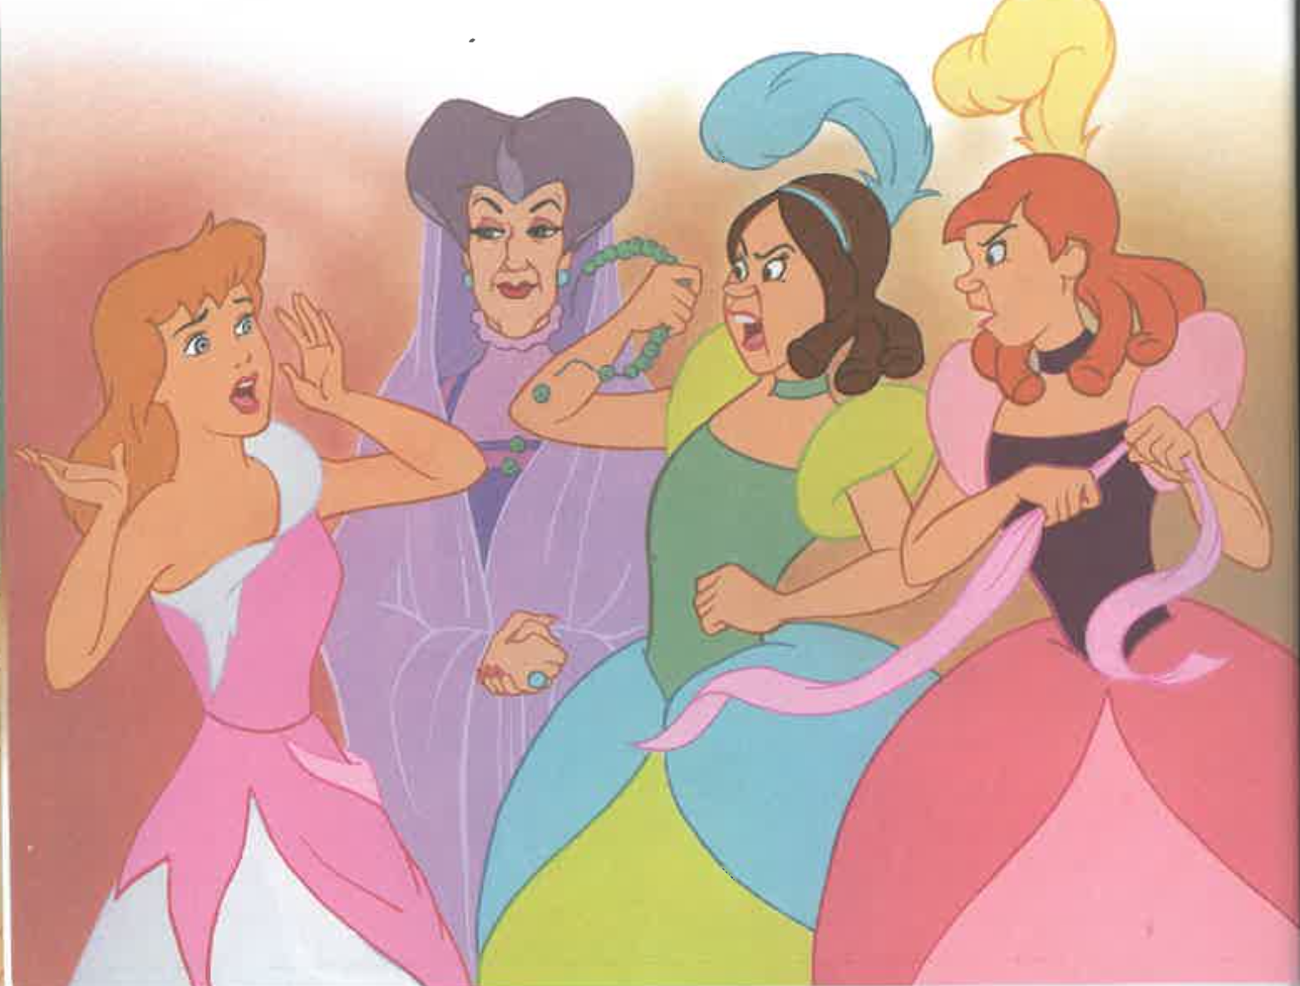

Slide 26
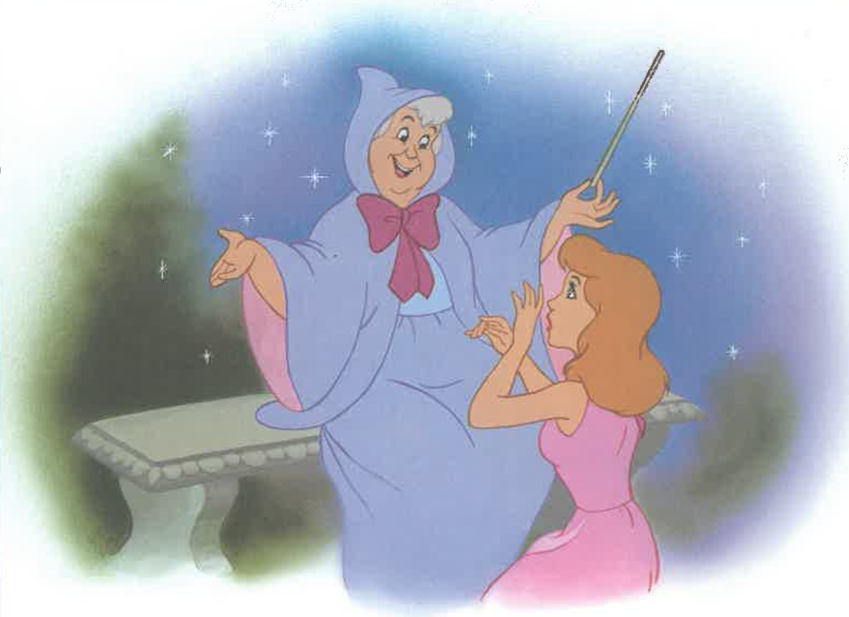

Slide 27
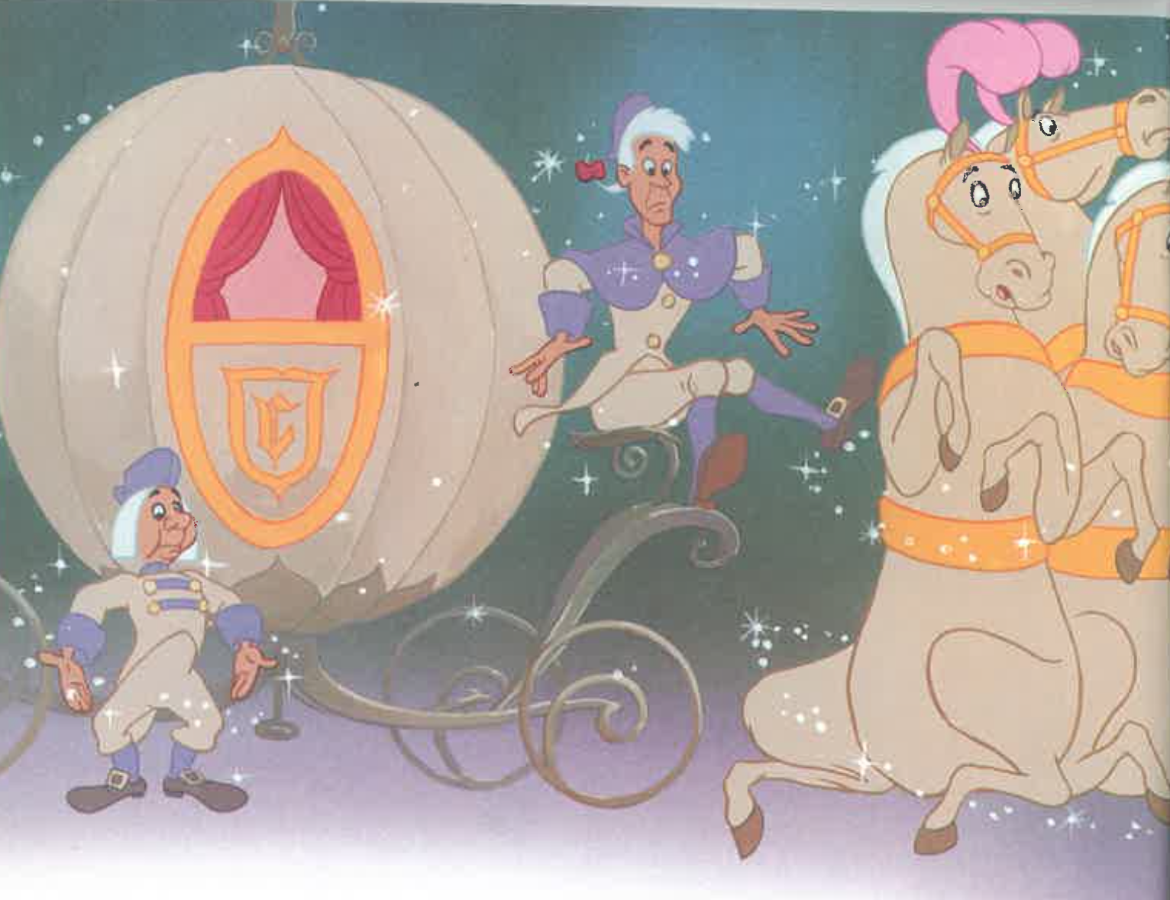

Slide 28
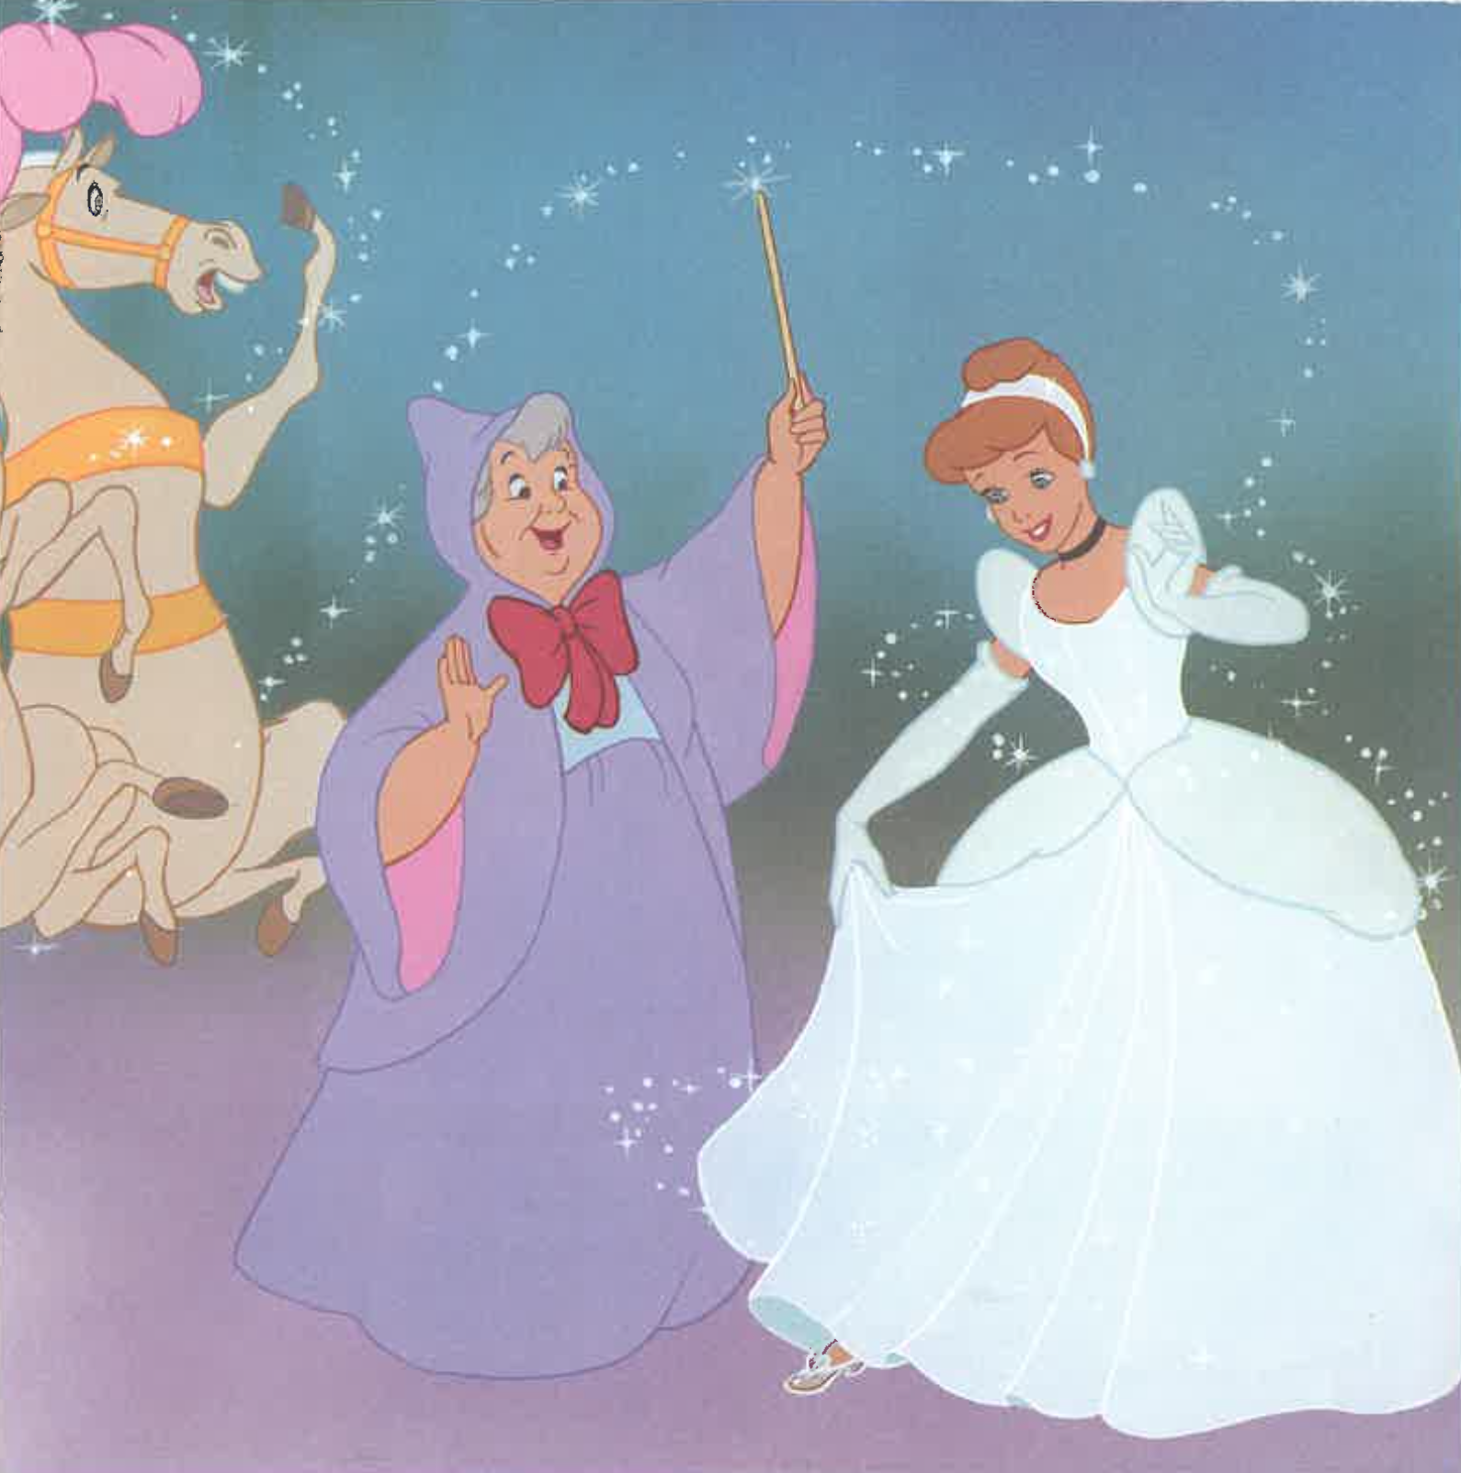

Slide 29
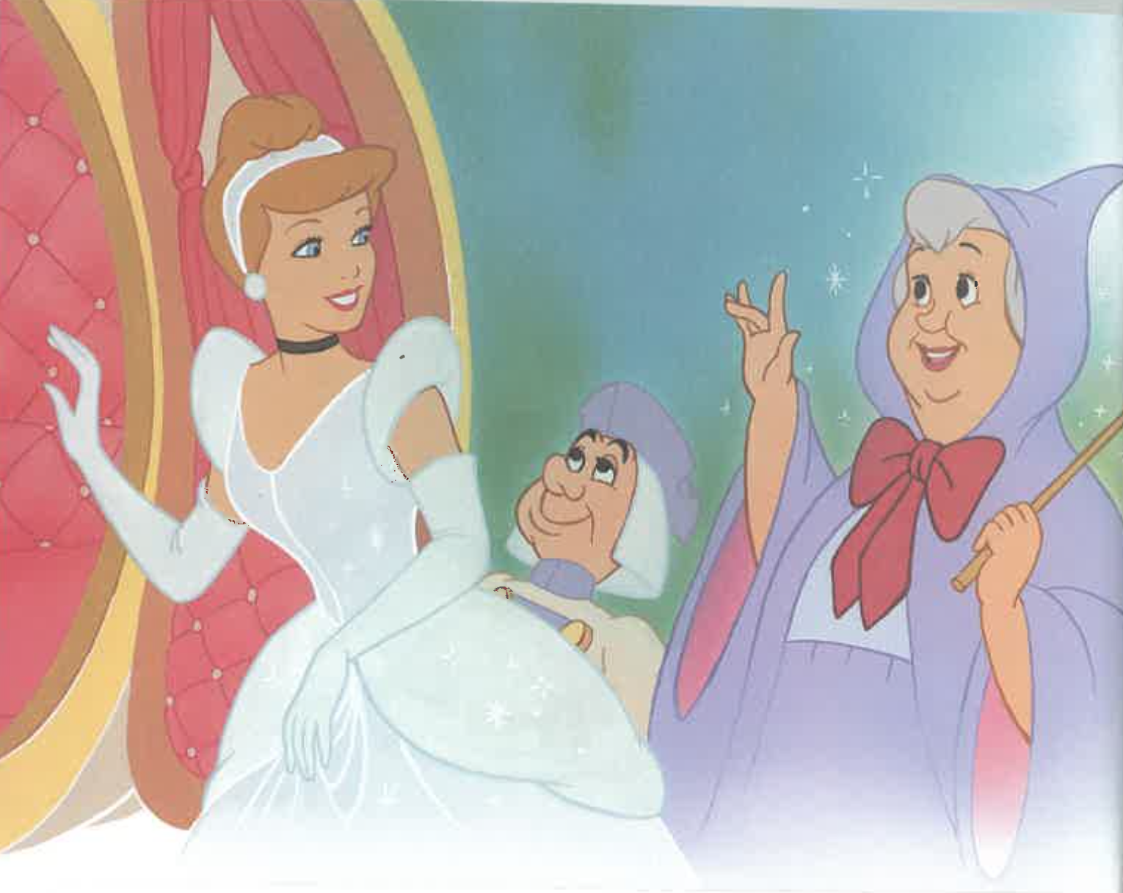

Slide 30
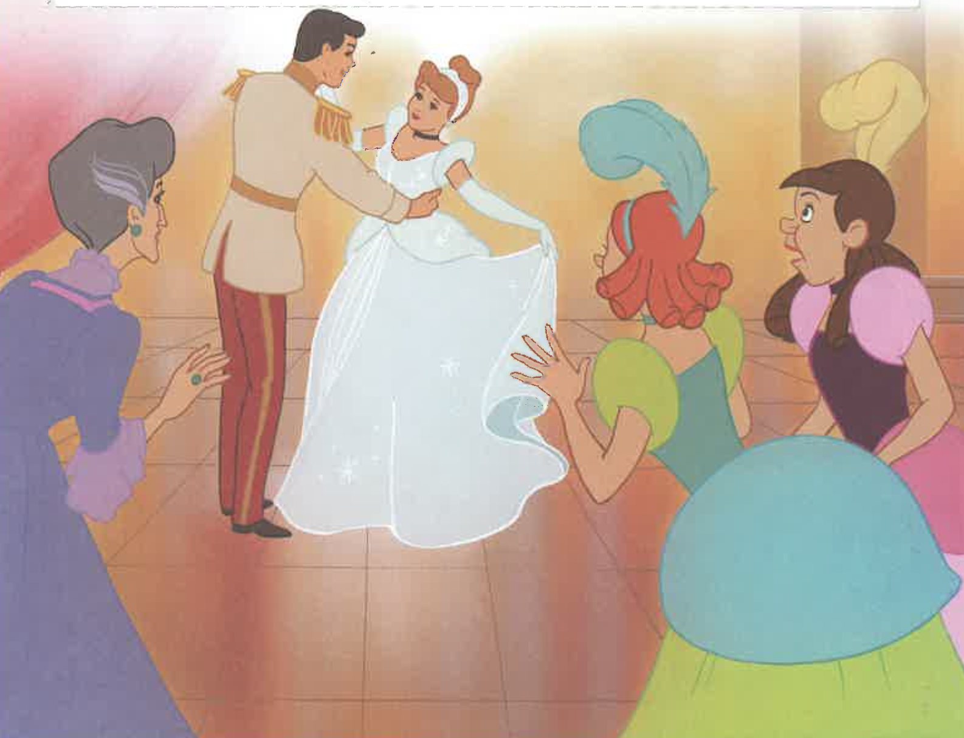

Slide 31
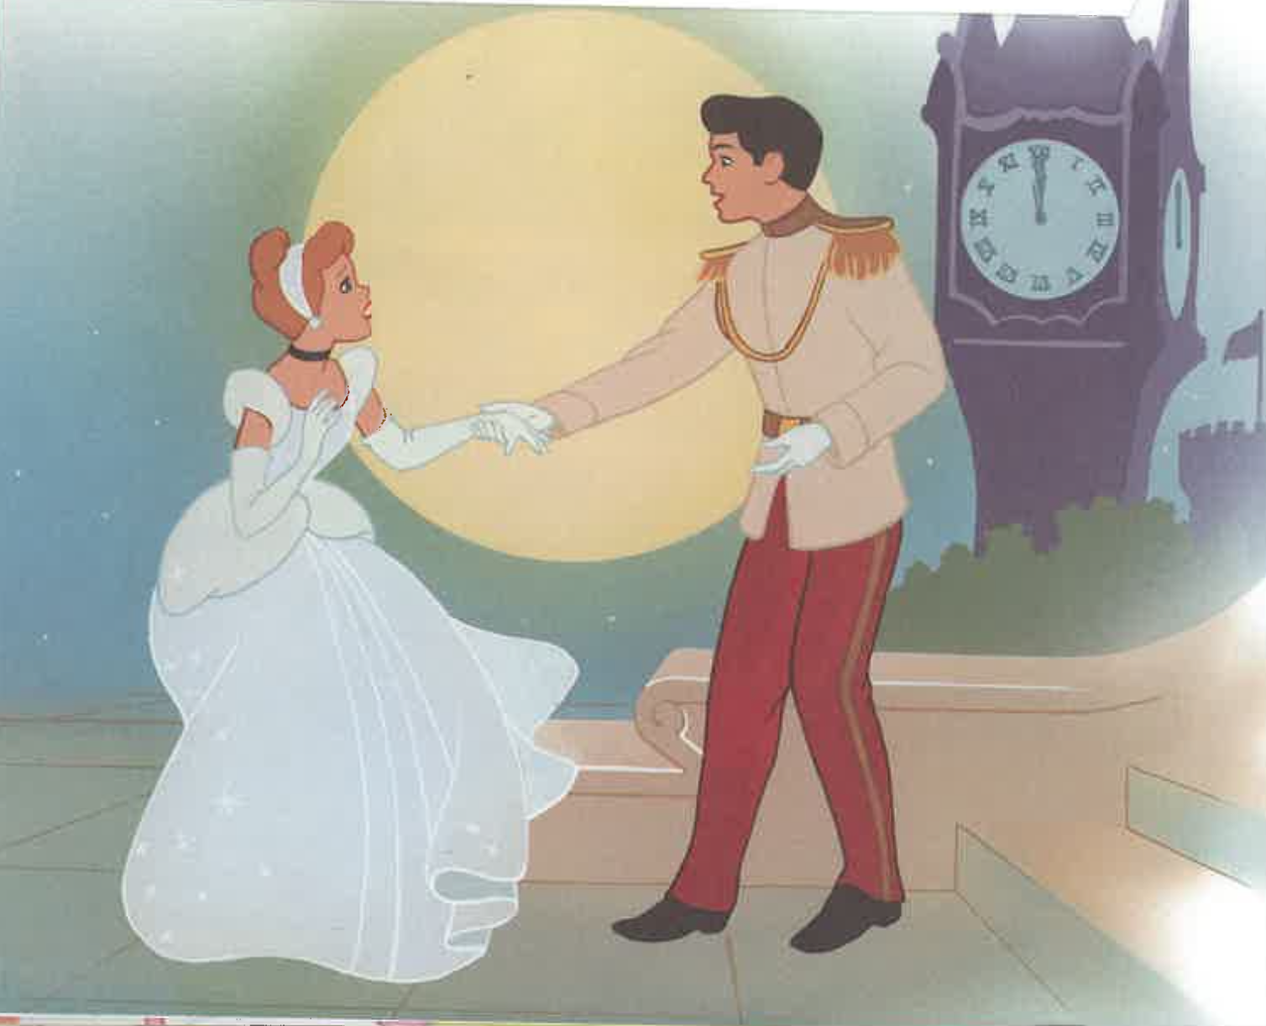

Slide 33
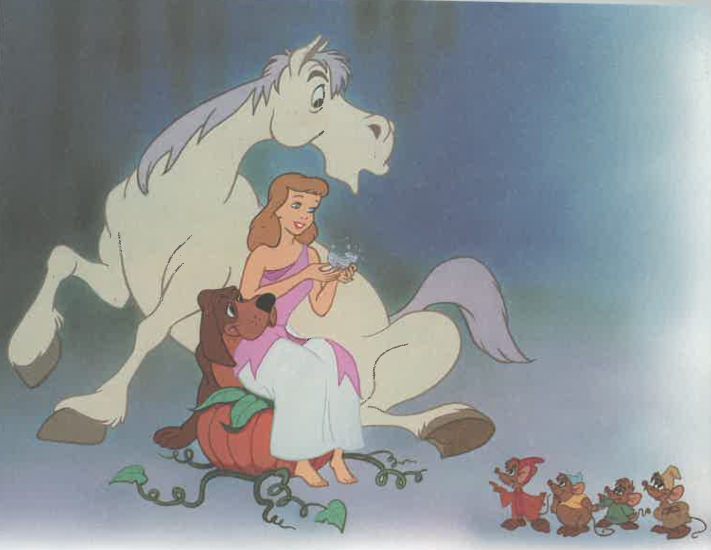

Slide 34
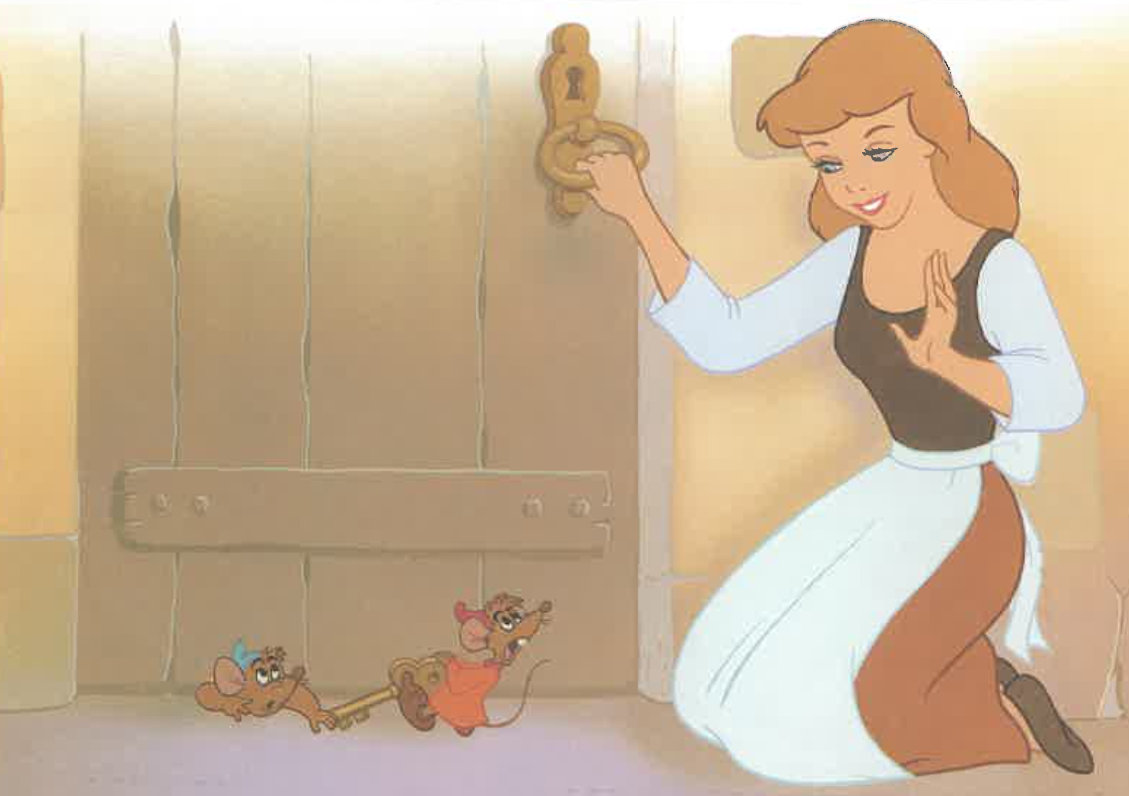

Slide 35
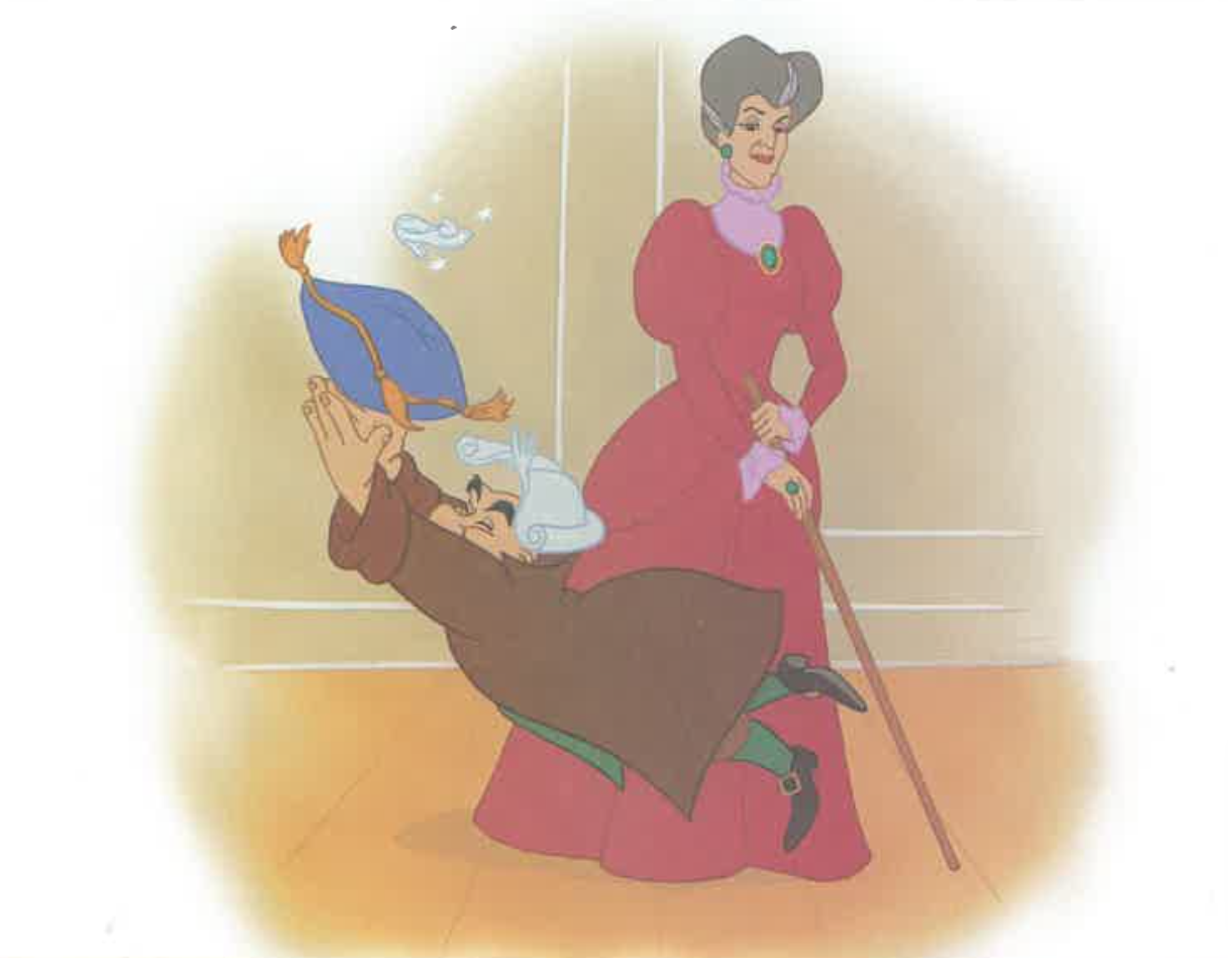

Slide 36
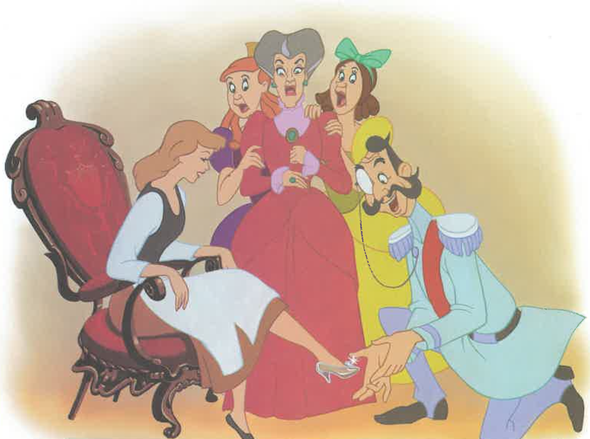

Slide 37
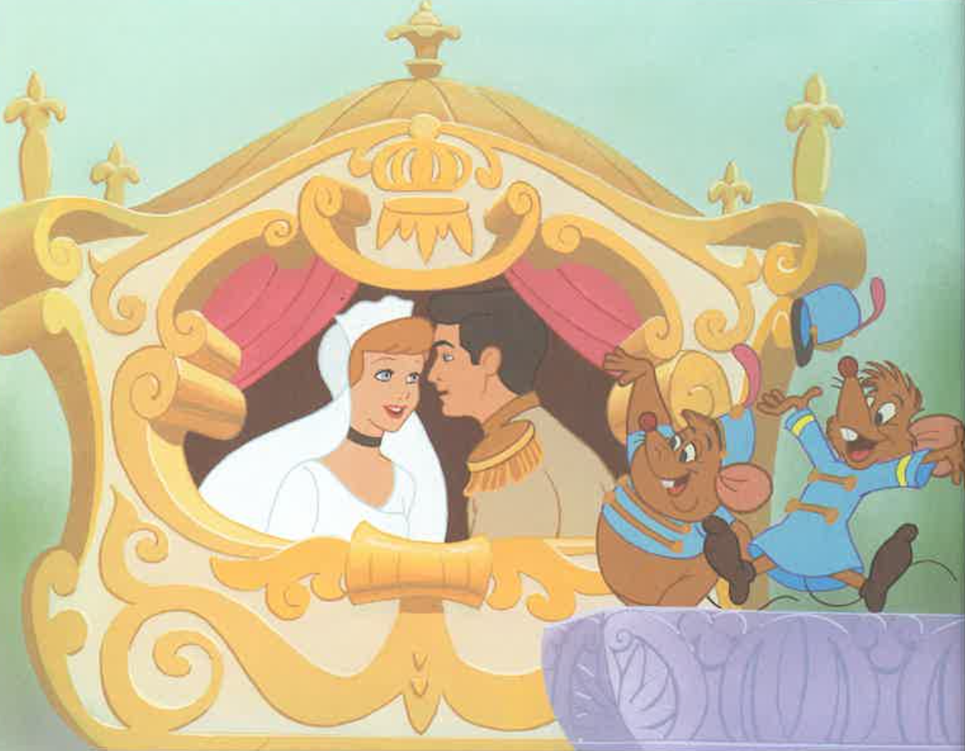

Slide 38
Notes:
Can you tell me the story of Cinderella?

Slide 39
Procedural Discourse
Notes:
Procedural Discourse Task (Sandwich) (~ 2 minutes)
Do not use a picture stimulus for this task.
“Let’s move on to something a little different. Tell me how you would make a peanut butter and jelly sandwich.”
(non-U.S. test sites may substitute another simple sandwich, such as Vegemite and cheese [Australia])
If no response in 10 seconds, give second prompt:
“If you were feeling hungry for a peanut butter and jelly sandwich, how would you make it?”

